Slide 1
V-Menu
Team Two

Slide 2

TEAM Members
Matthew Boyette – Lead Developer
David Hughes – Lead Designer
William Mejia – Developer
Demetrius Myers – Developer
Slaven Popadic – Developer

Slide 3
Trade Offs
-Need wireless access to use application
-Sacrifice in performance in favor of updates
-Potential lack of IT personal
-Single-pointed failure
-Investment

Slide 4
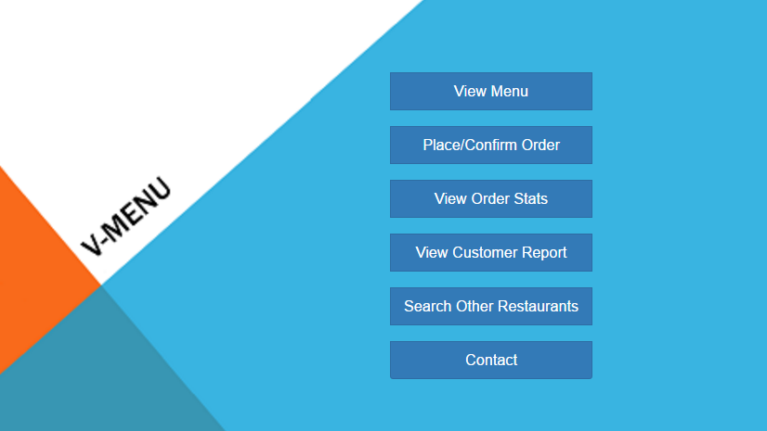
Main menu

Slide 5
Kitchen view

Slide 6
Manager View

Slide 7
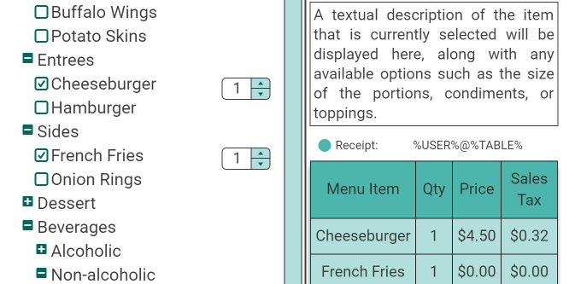
Example of order menu

Slide 8
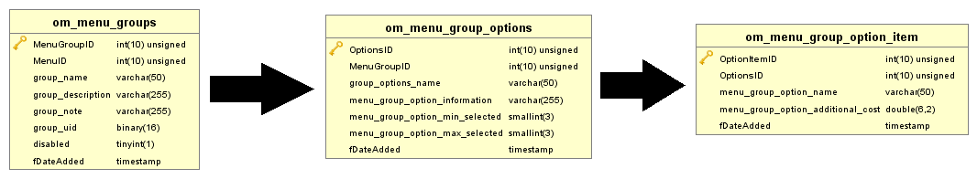

Slide 10
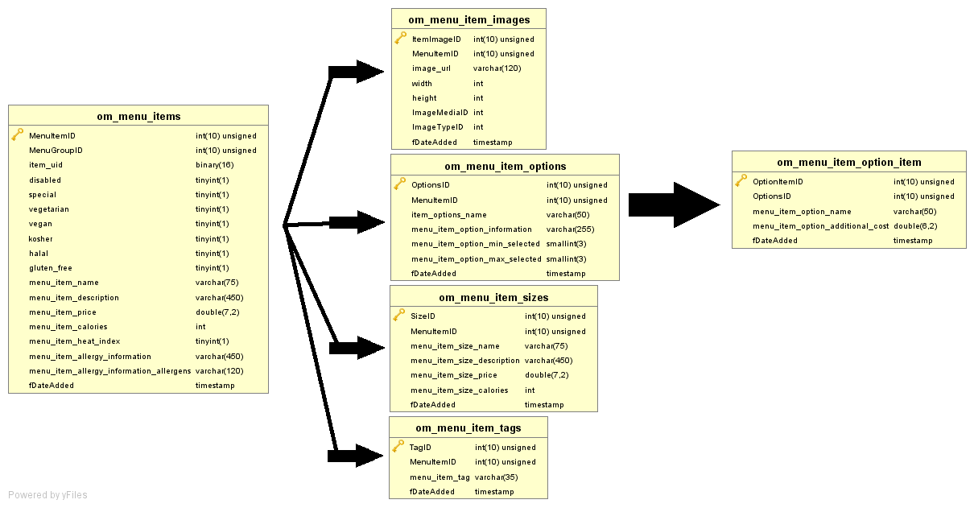

Slide 11


